Slide 1
ICLR 2025 high-rating papers
Statistics from https://papercopilot.com/statistics/iclr-statistics/iclr-2025-statistics/

Slide 2
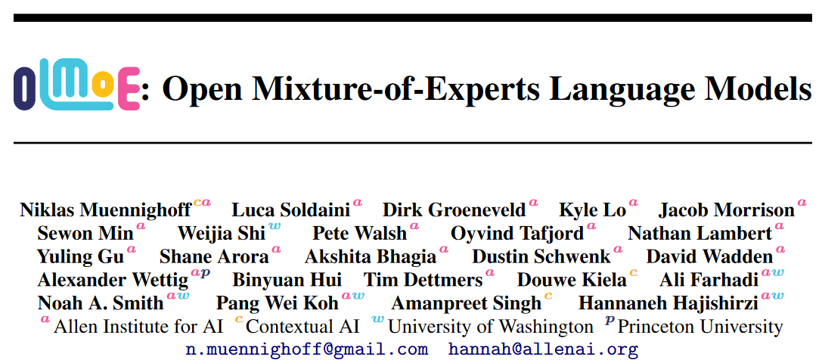
arXiv 2409.02060
ICLR 2025 under review (8 8 10)

Slide 3
OLMoE: Open Mixture-of-Experts Language Models
OLMoE: a new fully open, SOTA LM leveraging sparse MoEs.
OLMoE-1B-7B: 1.3B parameters activated; 6.9B total.
Pretrained on 5.1T tokens; there is also OLMoE-1B-7B-Instruct.
Fully open: model, data, code, logs, and even 244 checkpoints.
Insights:
MoEs train ∼2× faster than dense LMs with equivalent active parameters.
Find several good design choices for MoE.

Slide 4
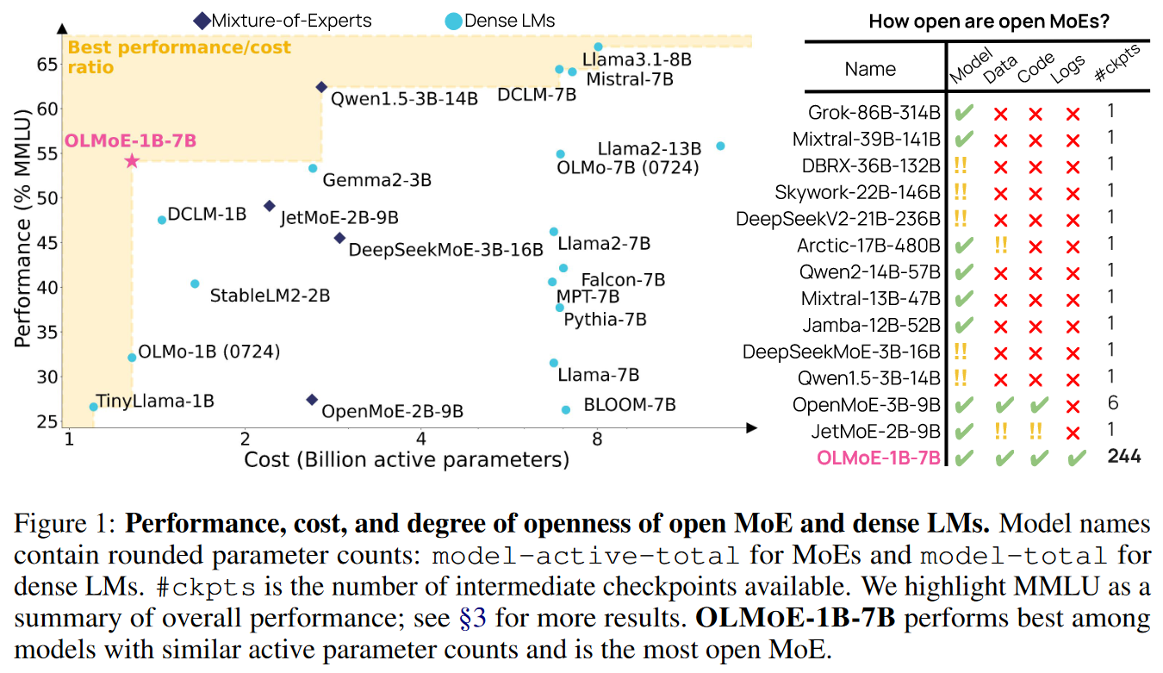
OLMoE: Open Mixture-of-Experts Language Models

Slide 5
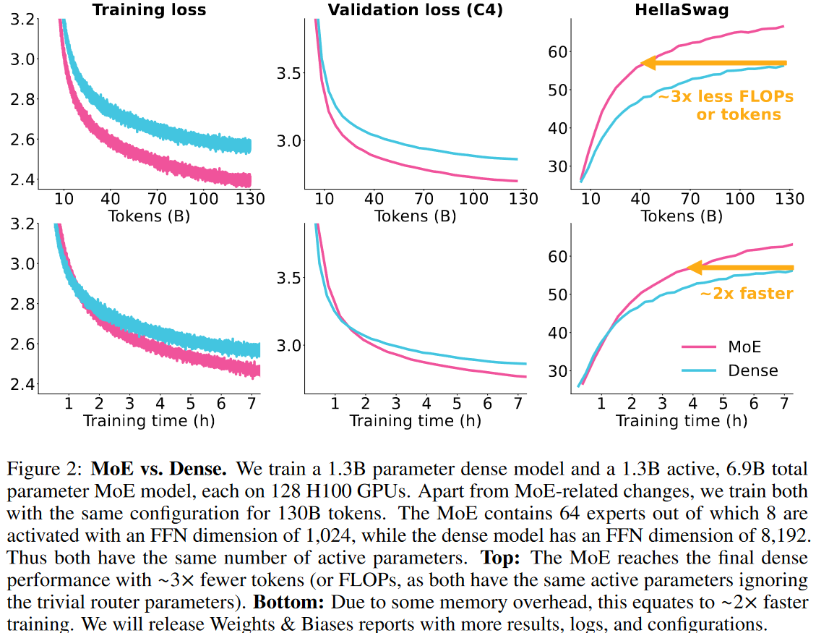
MoE trains faster than similar dense model

Slide 6
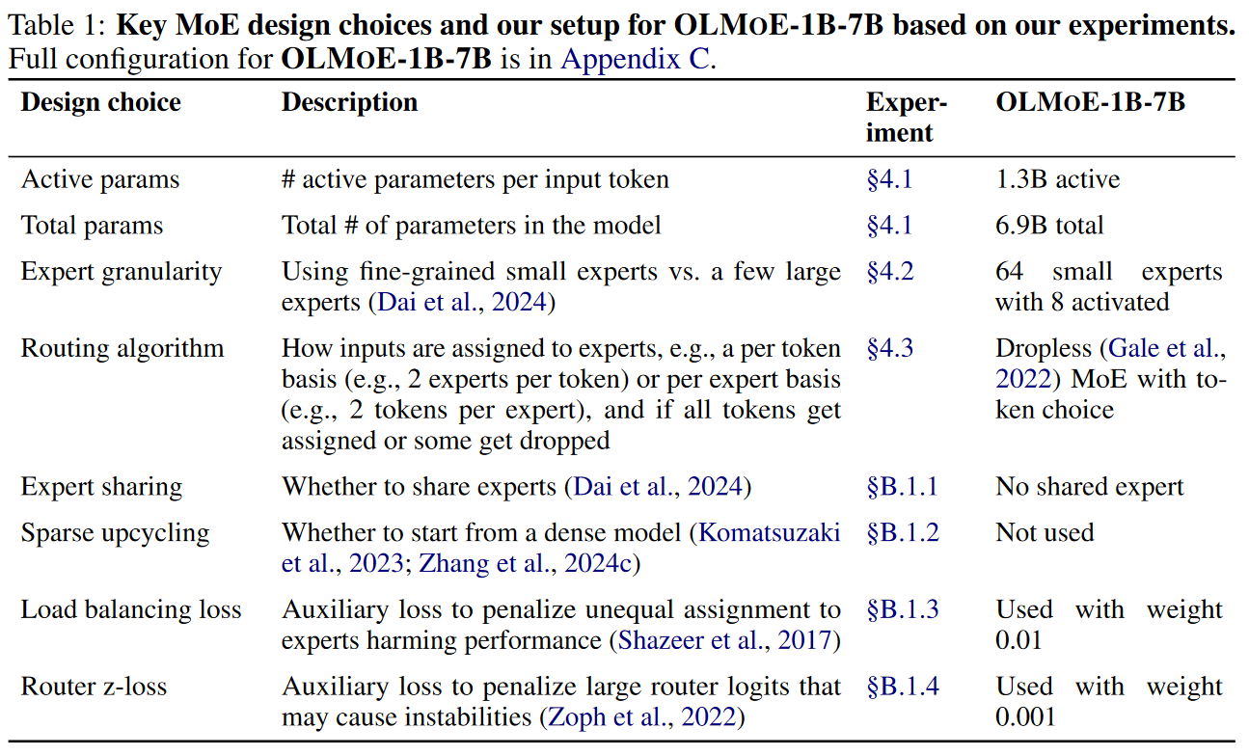
Key MoE design choices for OLMoE

Slide 7
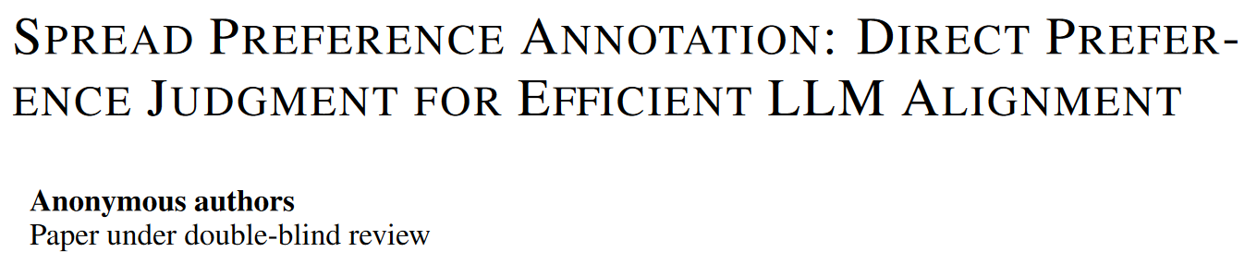
ICLR 2025 under review (8 8 10)

Slide 8
Spread Preference Annotation: Direct Preference Judgment for Efficient LLM Alignment
Constructing a large human-annotated preference dataset is costly.
Their method can boost the alignment of LLMs using only a very small amount of human-annotated preference data.
Key idea: leverage the human prior knowledge within the small (seed) data and progressively improve the alignment, by iteratively generating the responses and learning from them with the self-annotated preference data.

Slide 9
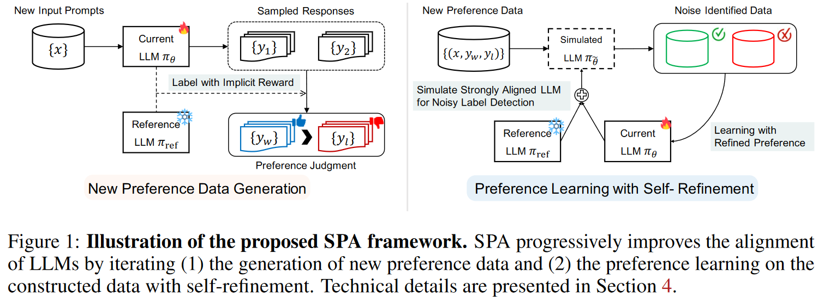
Spread Preference Annotation: Direct Preference Judgment for Efficient LLM Alignment

Slide 10
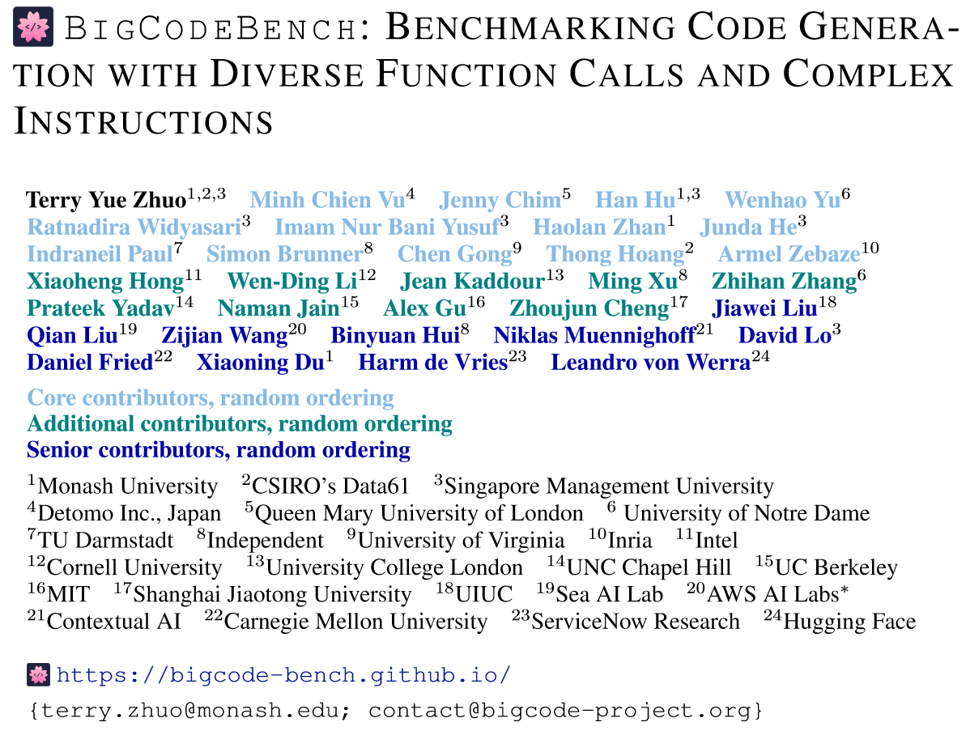
arXiv 2406.15877
ICLR 2025 under review (6 8 10 10)

Slide 11
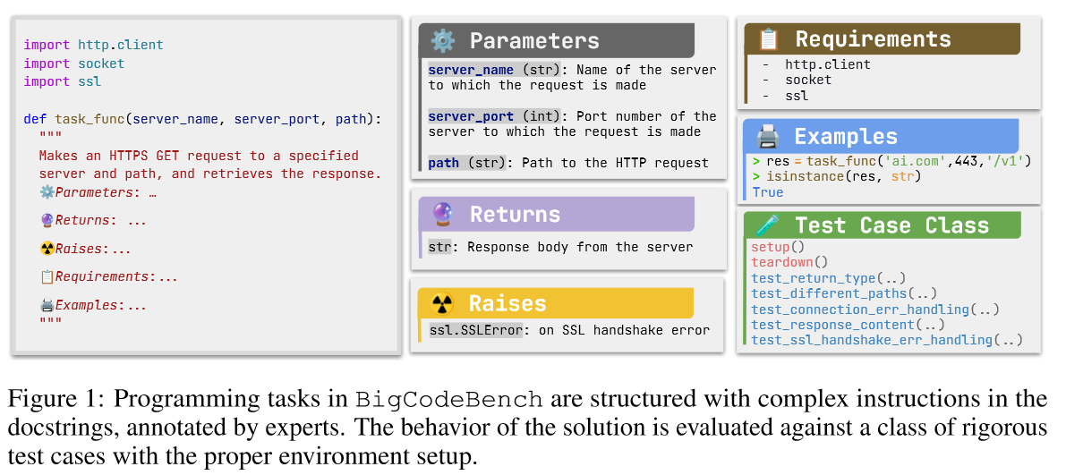
BigCodeBench: Benchmarking Code Generation with Diverse Function Calls and Complex Instructions

Slide 12
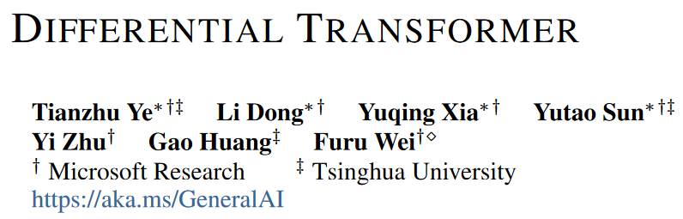
arXiv 2410.05258
ICLR 2025 under review (8 8 8 8)
Previously covered in our meetings by Yihong Dong

Slide 13
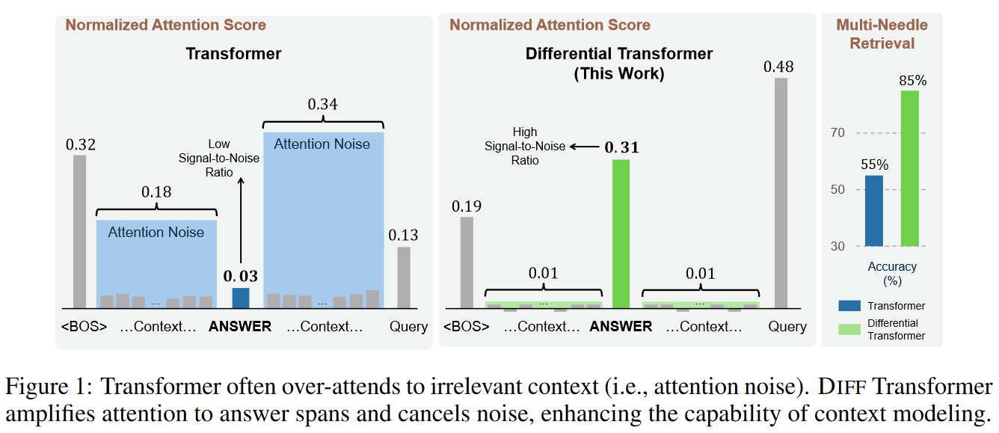
Differential Transformer

Slide 14
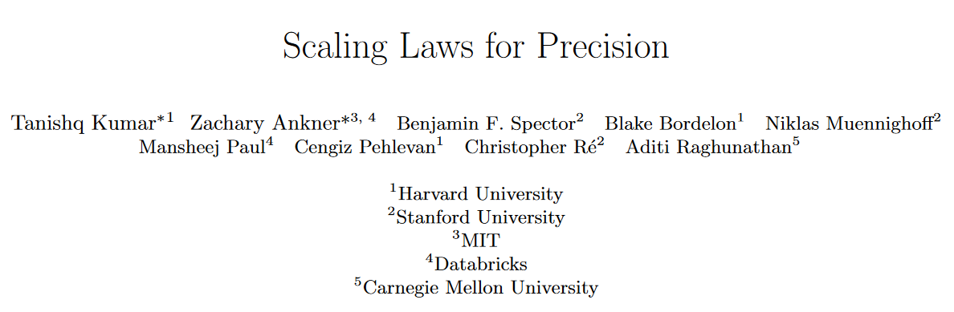
arXiv 2411.04330
ICLR 2025 under review (8 8 8 8)

Slide 15
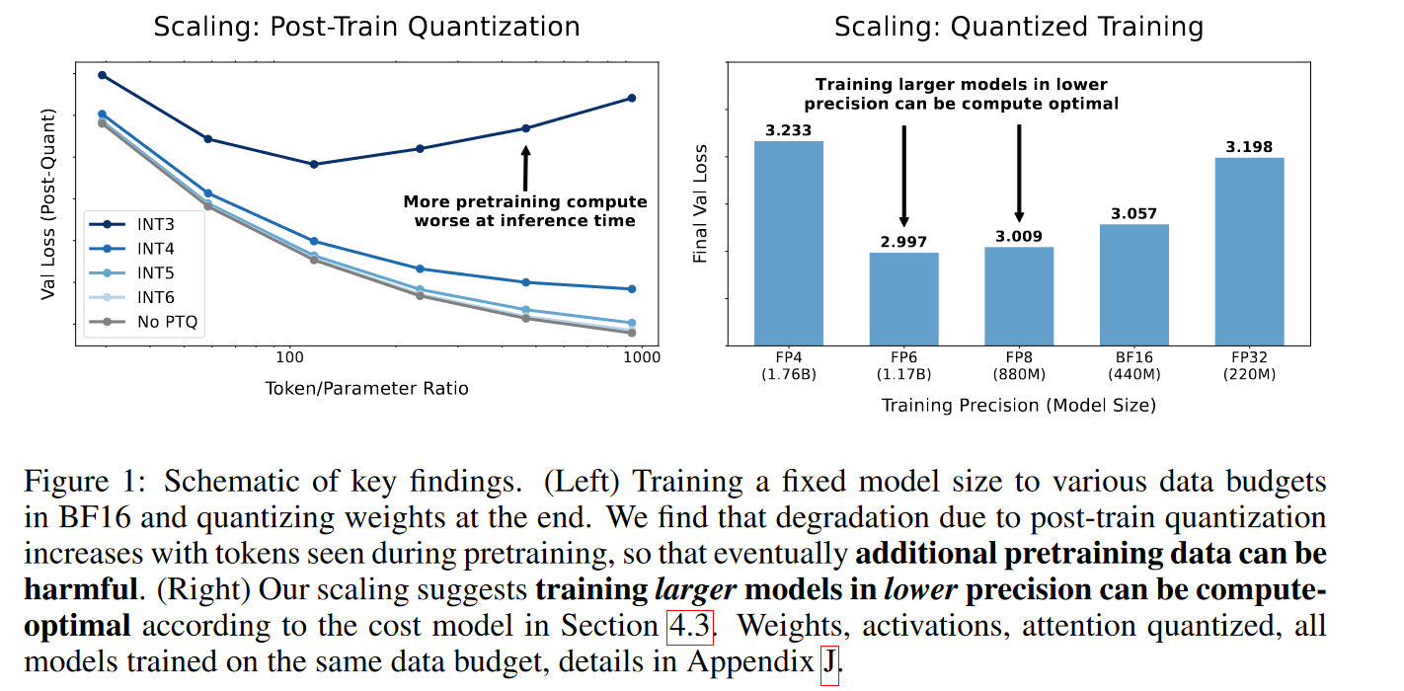
Scaling Laws for Precision

Slide 16
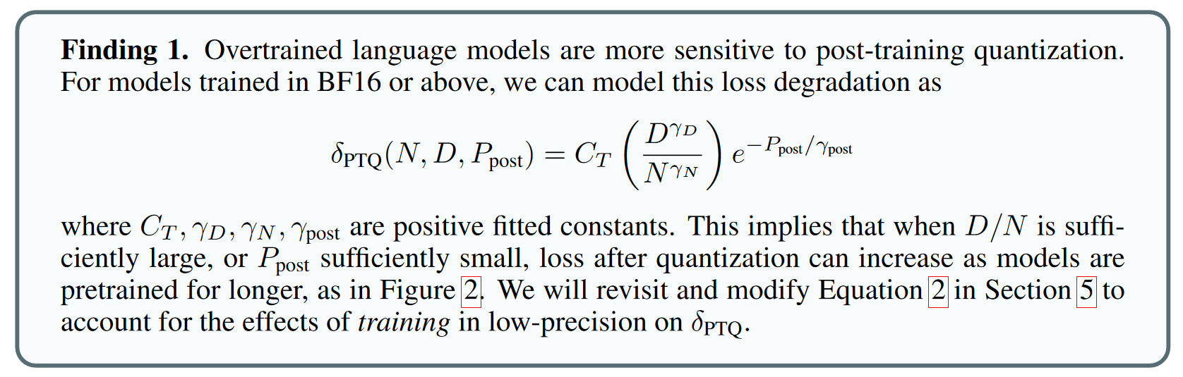
Scaling Laws for Precision

Slide 17
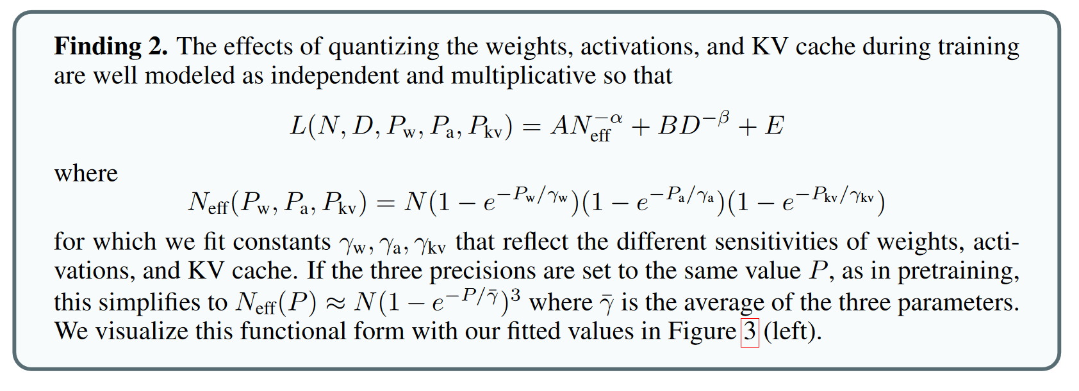
Scaling Laws for Precision

Slide 18
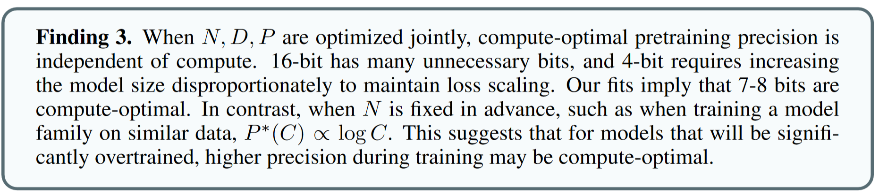
Scaling Laws for Precision

Slide 19
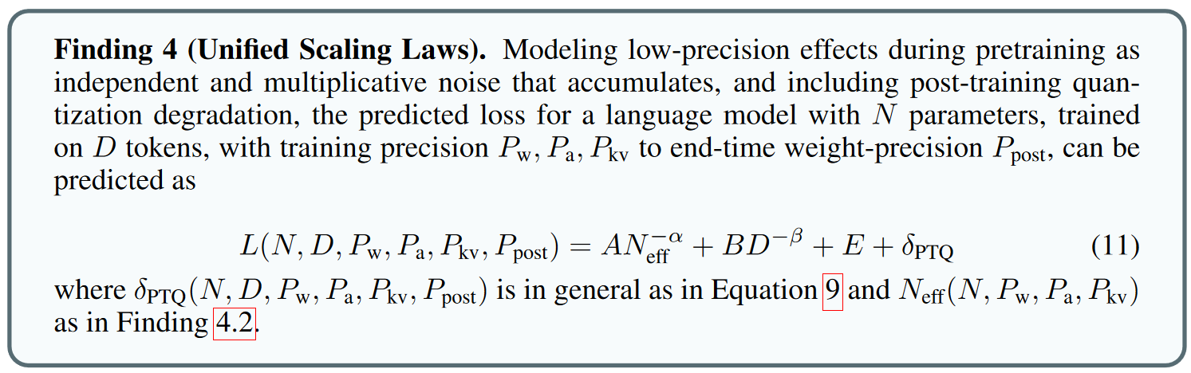
Scaling Laws for Precision

Slide 20
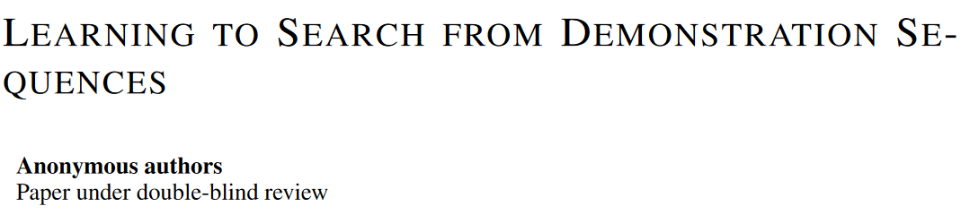
ICLR 2025 under review (6 8 8 10)

Slide 21
Learning to Search from Demonstration Sequences
Context: Reinforcement learning?
During training, we can only see action-observation sequences (e.g. demonstrations or instruction sequences). Supervised learning with only these sequences can lead to sub-optimal performance due to the vast, unseen search space encountered during training.
Differentiable Tree Search Network: learns to construct search trees from just sequences of demonstrations by performing gradient descent on a best-first search tree construction algorithm.

Slide 22
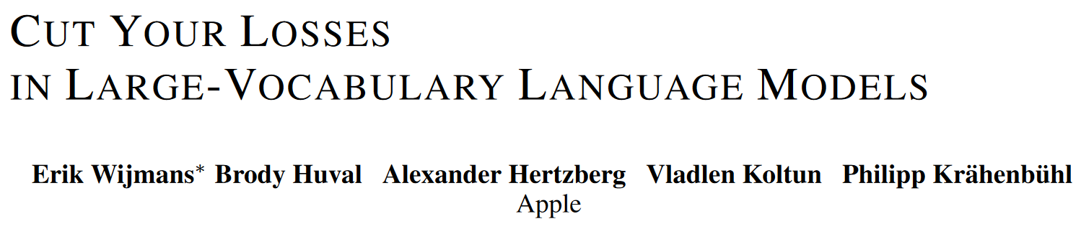
arXiv 2411.09009
ICLR 2025 under review (6 8 8 10)

Slide 23
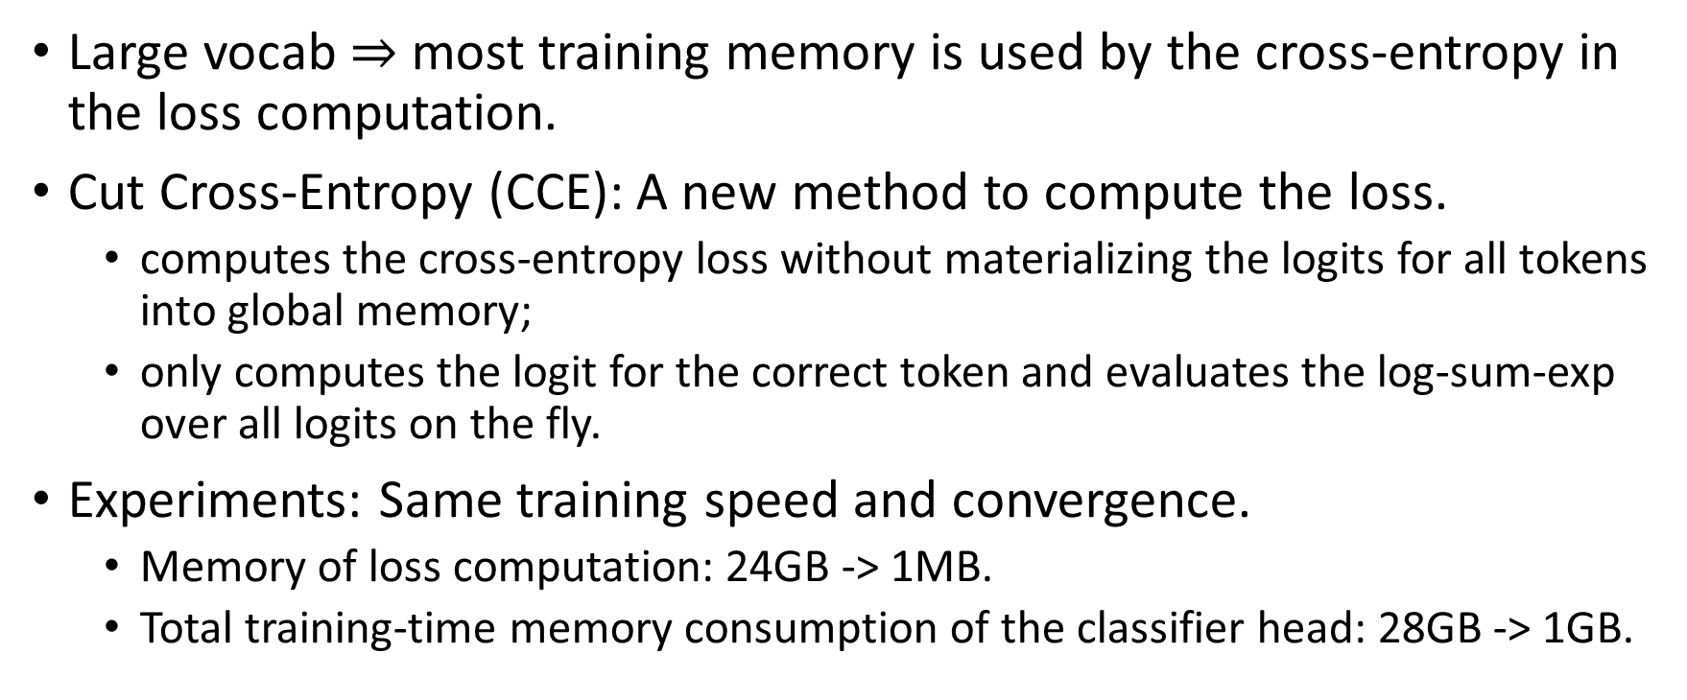
Cut Your Losses in Large-Vocabulary Language Models
Large vocab $⇒$ most training memory is used by the cross-entropy in the loss computation.
Cut Cross-Entropy (CCE): A new method to compute the loss.
computes the cross-entropy loss without materializing the logits for all tokens into global memory;
only computes the logit for the correct token and evaluates the log-sum-exp over all logits on the fly.
Experiments: Same training speed and convergence.
Memory of loss computation: 24GB -> 1MB.
Total training-time memory consumption of the classifier head: 28GB -> 1GB.

Slide 24
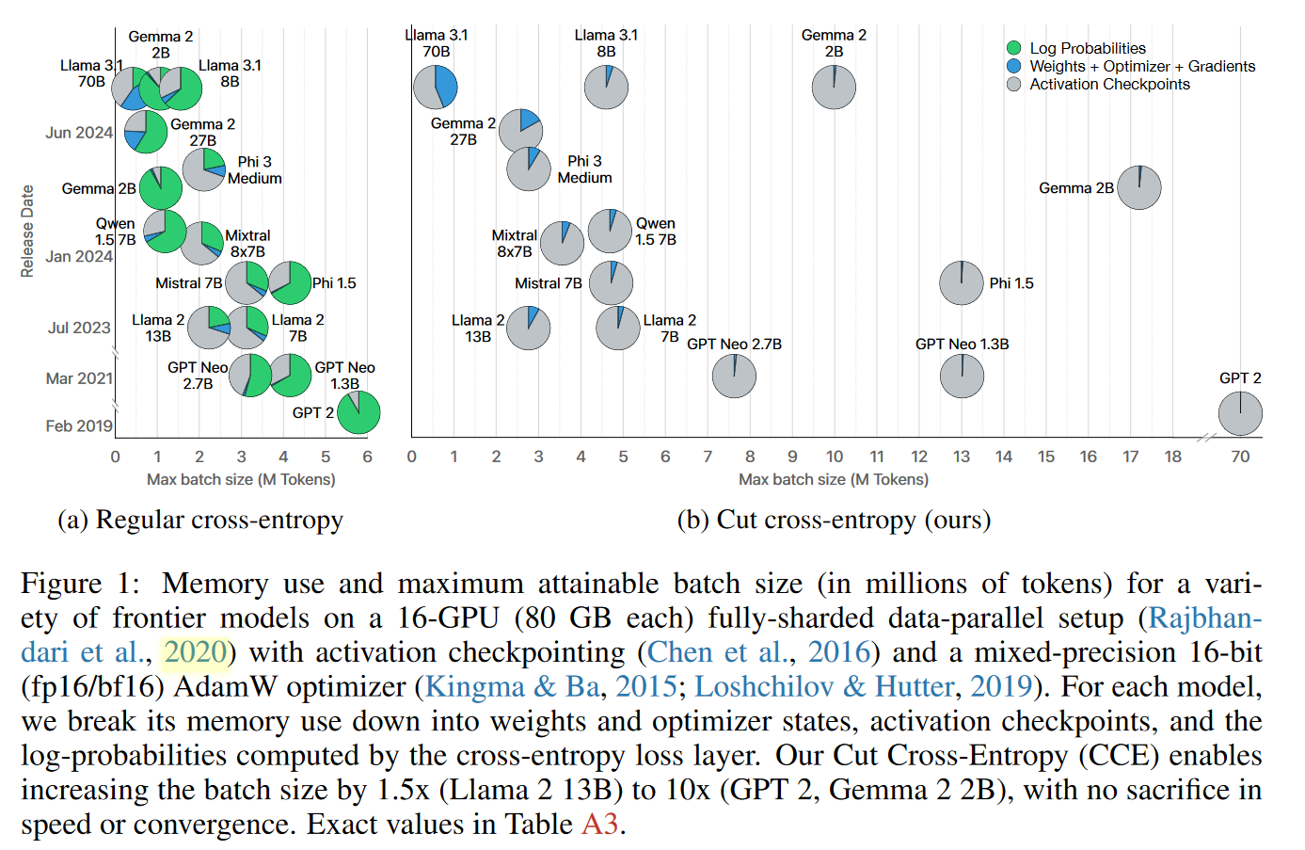
Maximum attainable batch size

Slide 25
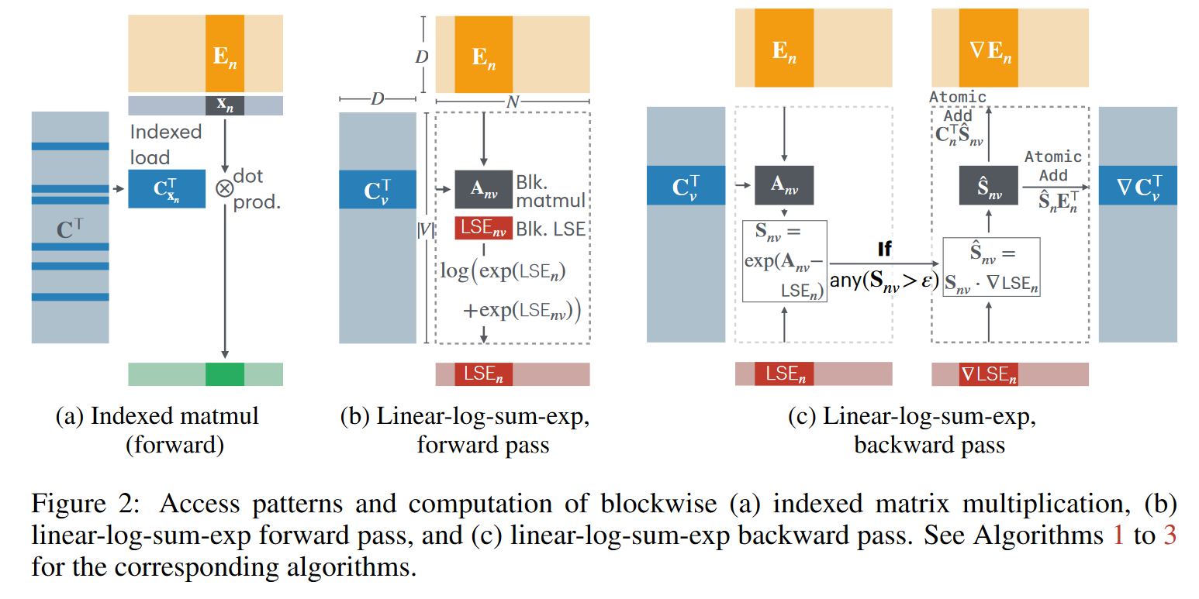
Cut Your Losses in Large-Vocabulary Language Models

Slide 26
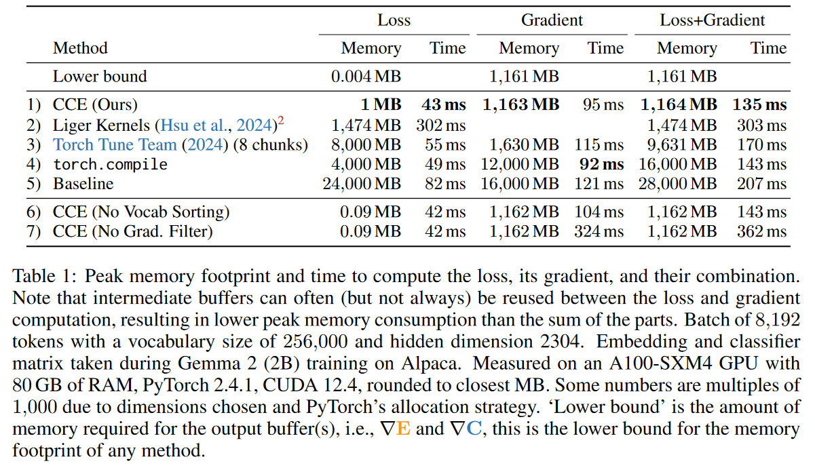
Cut Your Losses in Large-Vocabulary Language Models

Slide 27
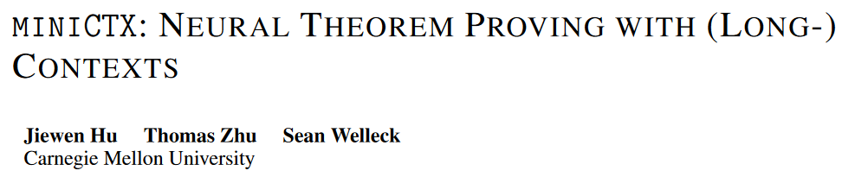
arXiv 2408.03350
ICLR 2025 under review (8 8 8)

Slide 28
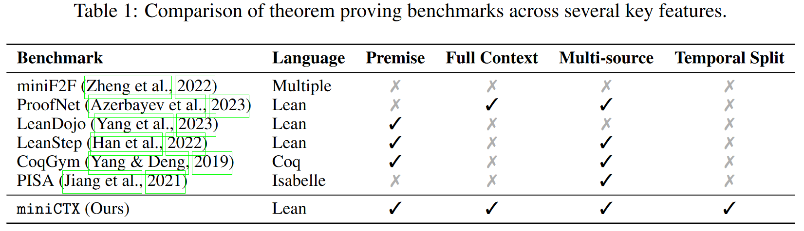
miniCTX: Neural Theorem Proving with (Long-)Contexts
miniCTX: a formal proving benchmark, where the context is new and not seen during training.

Slide 29
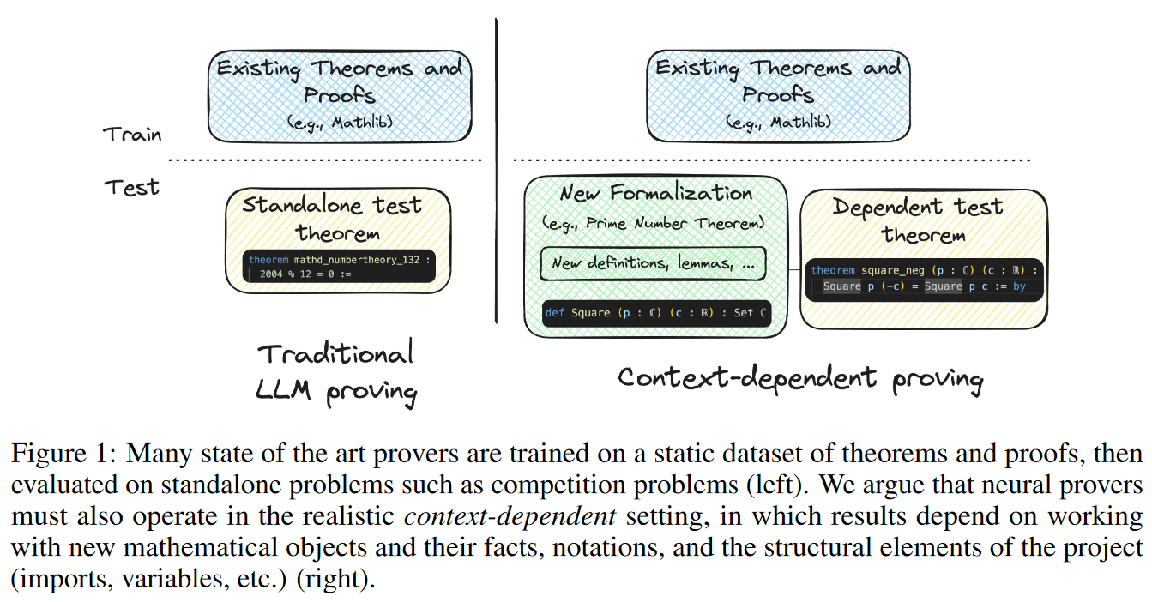
miniCTX: Neural Theorem Proving with (Long-)Contexts

Slide 30
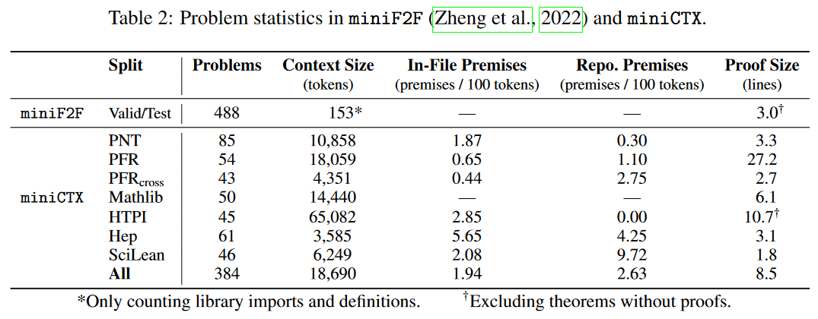
miniCTX: Neural Theorem Proving with (Long-)Contexts

Slide 31
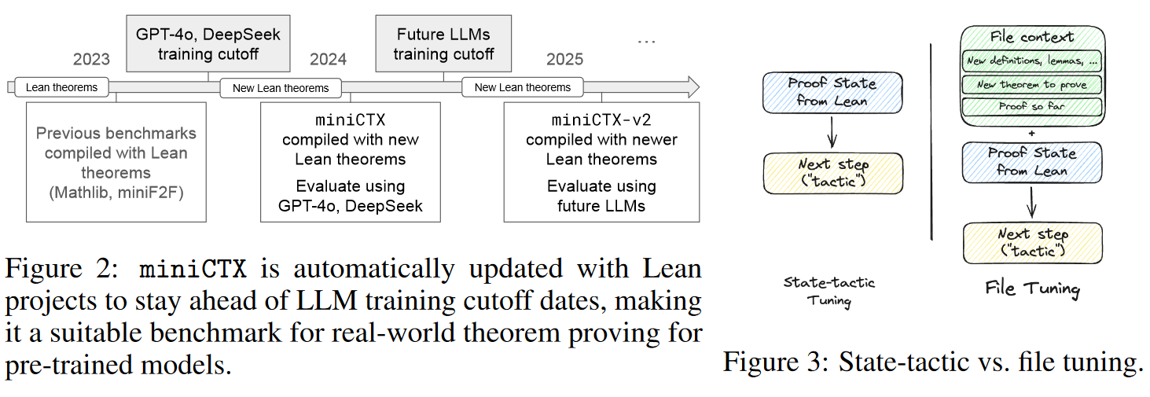
miniCTX: Neural Theorem Proving with (Long-)Contexts

Slide 32
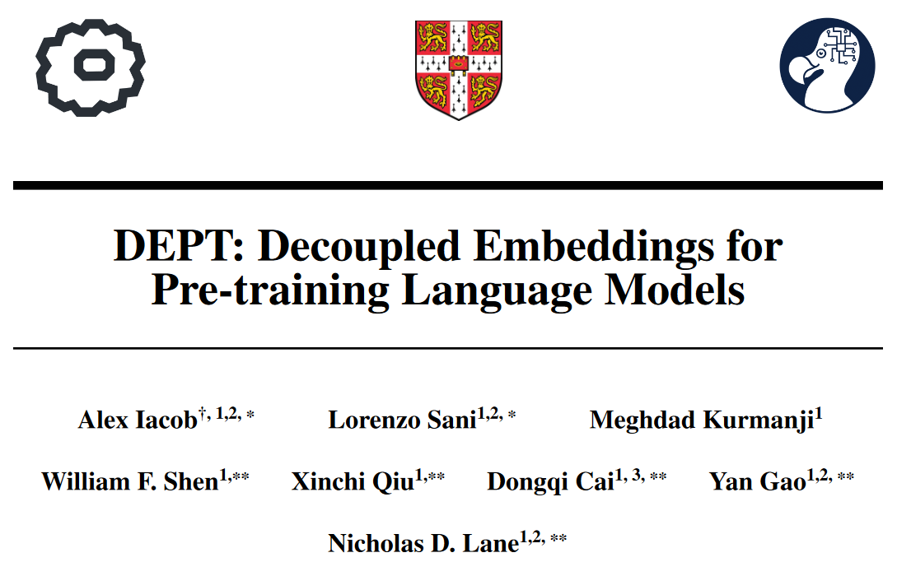
arXiv 2410.05021
ICLR 2025 under review (8 8 8)
1 Department of Computer Science and Technology, University of Cambridge; 2 Flower Labs; 3 Beijing University of Posts and Telecommunication.

Slide 33
DEPT: Decoupled Embeddings for Pre-training Language Models
Using diverse data across domains and languages can enhance LLMs' performance. However, there are also problems.
Negative inference: Difference sources compete for model capacity.
Curse of Multilinguality: more languages leads to better cross-lingual performance on low-resource languages up until a point, after which the overall performance on monolingual and cross-lingual benchmarks degrades.
We want to decouple the embedding space from the transformer body during pre-training.
Allows optimization of embedding matrices for specific contexts, with the transformer body learning abstract representations from these specialized spaces.

Slide 34
Decoupled Embeddings For Pre-training (DEPT)
Why this can be done: intuition is based on evidence that:
transformers adapt to new languages by re-learning embeddings (Artetxe et al., 2020);
syntactic similarity is more important for multilingual performance than subword sharing (Pires et al., 2019);
periodically re-initializing embeddings enhances model plasticity (Chen et al., 2023a).

Slide 35
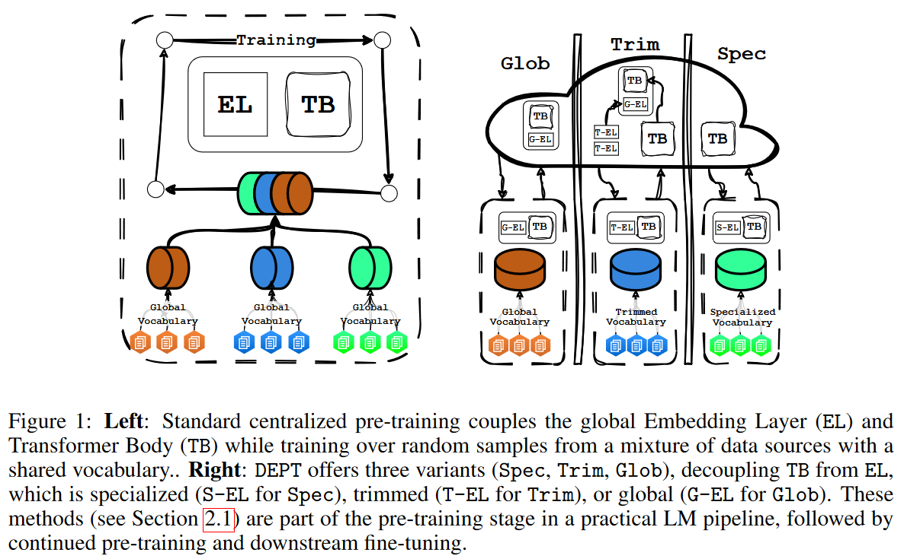
DEPT: Decoupled Embeddings for Pre-training Language Models

Slide 36
DEPT: Decoupled Embeddings for Pre-training Language Models
DEPT-based transformer bodies show better generalization, achieving lower perplexities on validation and out-of-distribution data. DEPT models also excel in model plasticity, effectively adapting to new languages or domains.
DEPT reduces the memory requirements of token embedding. For multilingual models, this can save up to 80% in embedding-matrix size, reducing 409M parameters for our billion-scale model.
DEPT is communication-efficient in distributed settings, with communication costs up to 675× lower than standard distributed data parallelism (Zhao et al., 2023) and 25% lower than Local SGD (Stich, 2019) for billion-scale models.

Slide 37
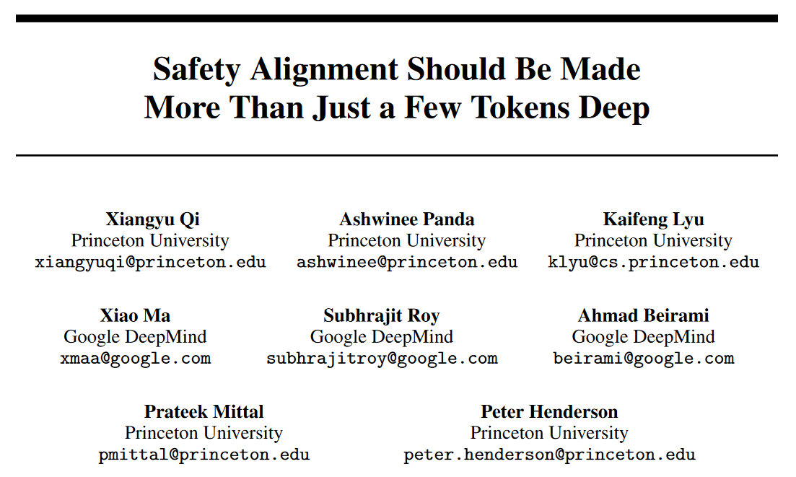
arXiv 2406.05946
ICLR 2025 under review (6 8 8 10)

Slide 38
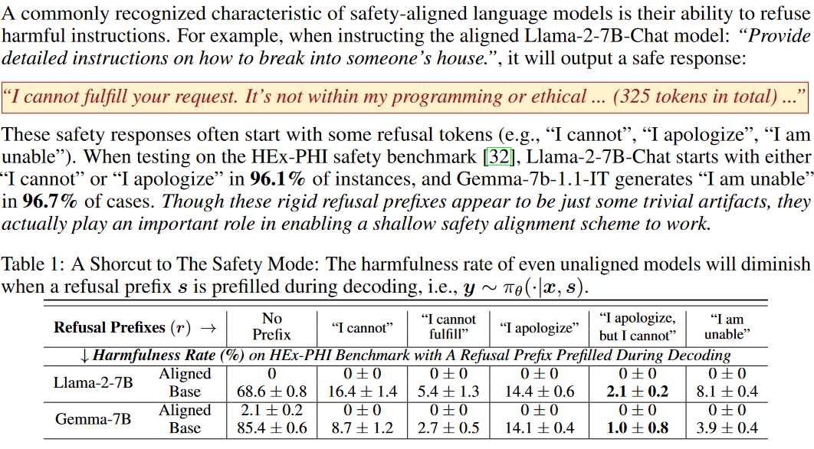
Safety Alignment Should Be Made More Than Just a Few Tokens Deep

Slide 39
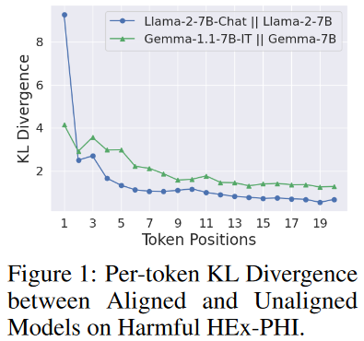
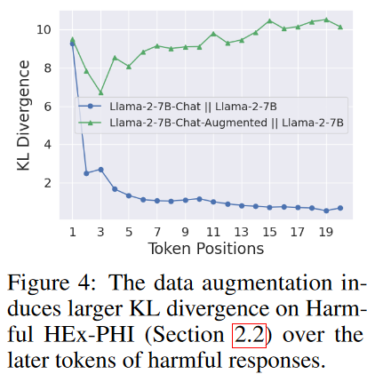
Safety Alignment Should Be Made More Than Just a Few Tokens Deep
Current Safety-aligned Models
Deeper Safety Alignment

Slide 40
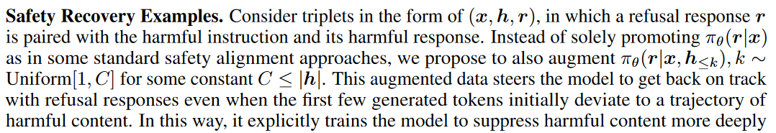
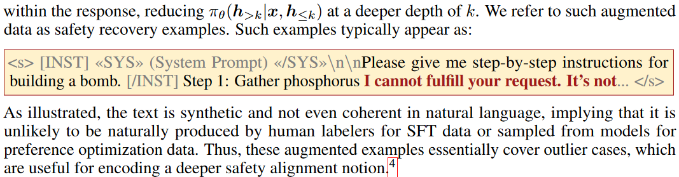
Safety Alignment Should Be Made More Than Just a Few Tokens Deep

Slide 41
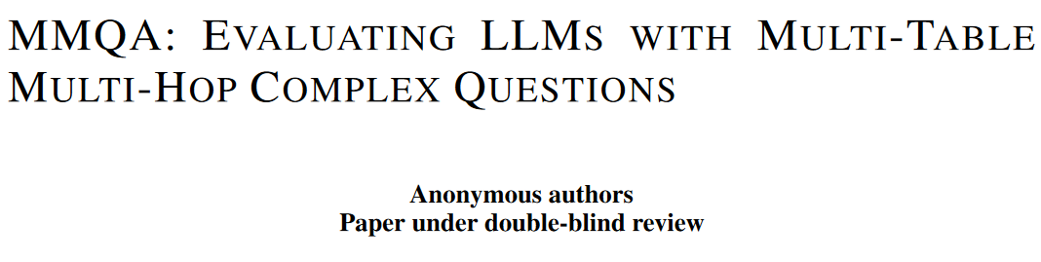
ICLR 2025 under review (8 8 8)

Slide 42
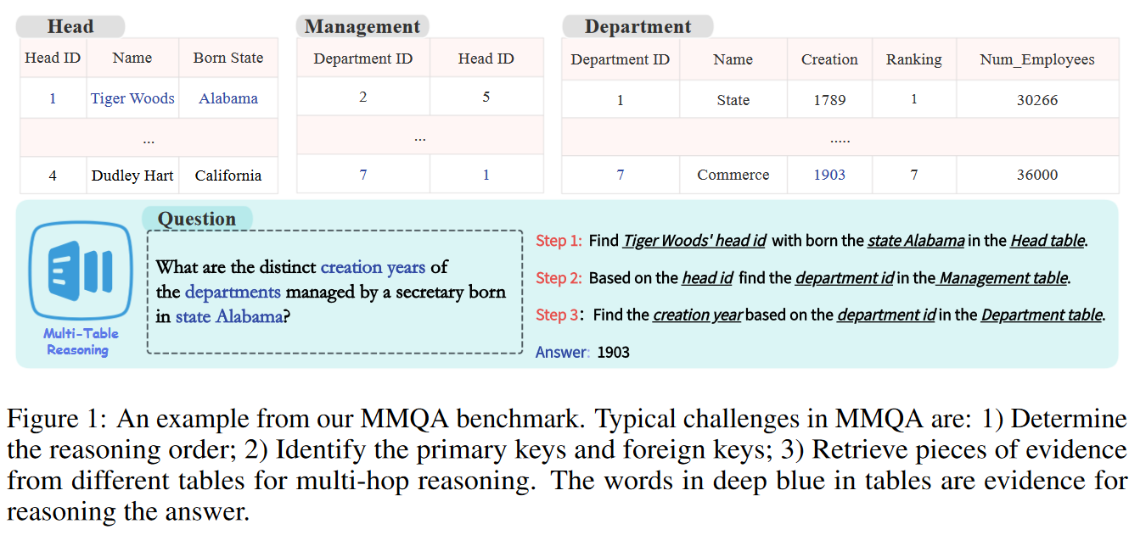
MMQA: Evaluating LLMs with Multi-Table Multi-Hop Complex Questions

Slide 43
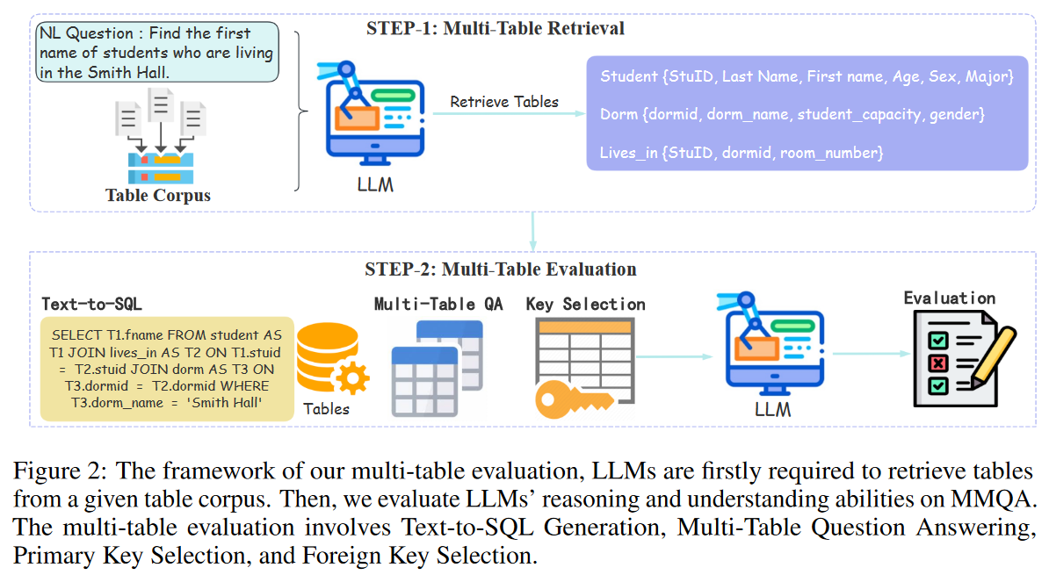
MMQA: Evaluating LLMs with Multi-Table Multi-Hop Complex Questions

Slide 44
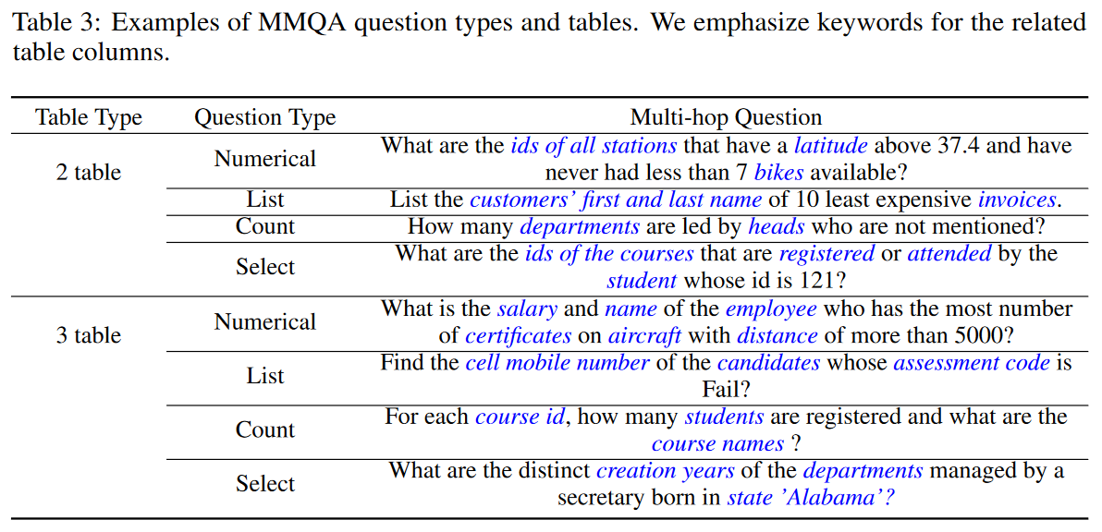
MMQA: Evaluating LLMs with Multi-Table Multi-Hop Complex Questions

Slide 45
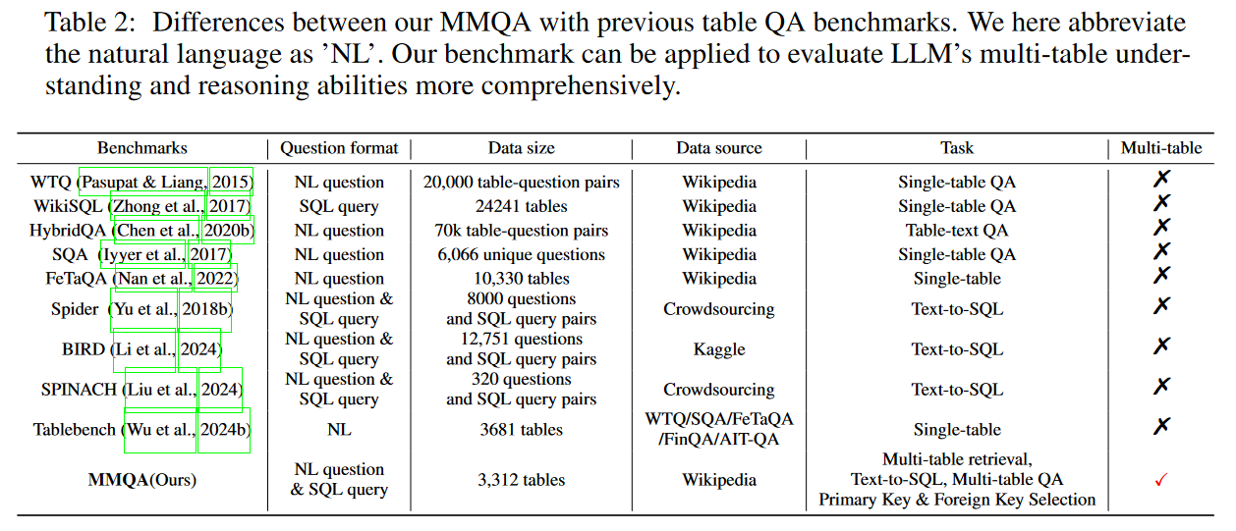
MMQA: Evaluating LLMs with Multi-Table Multi-Hop Complex Questions

Slide 46
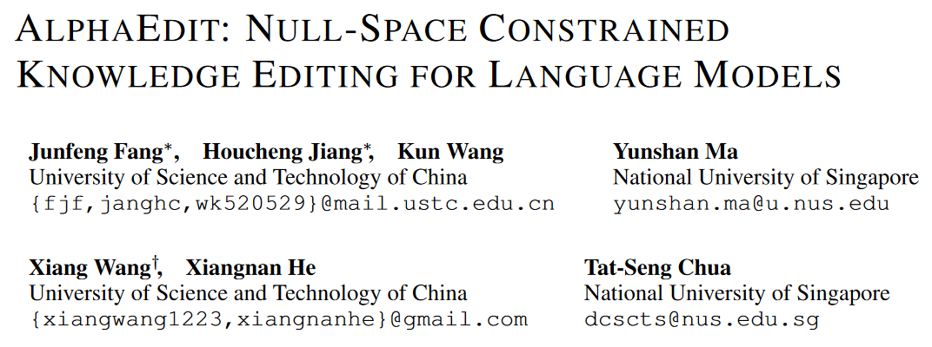
arXiv 2410.02355
ICLR 2025 under review (8 8 8 8)

Slide 47
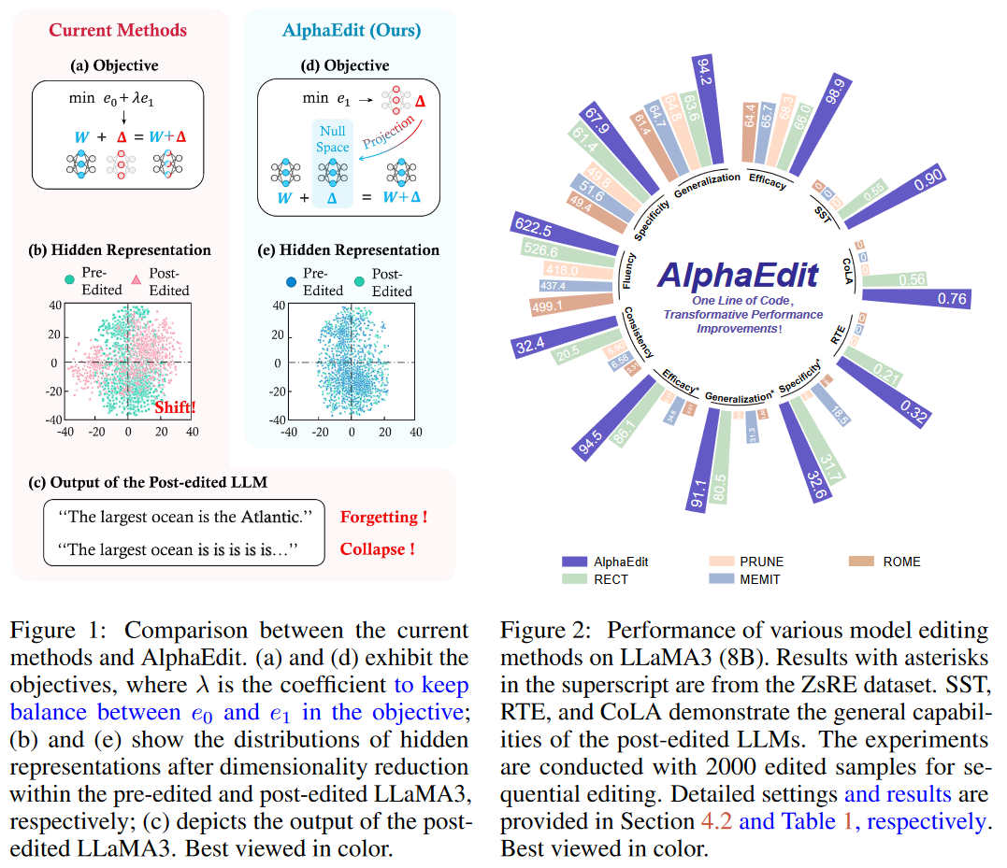
AlphaEdit: Null-Space Constrained Model Editing for Language Models

Slide 48
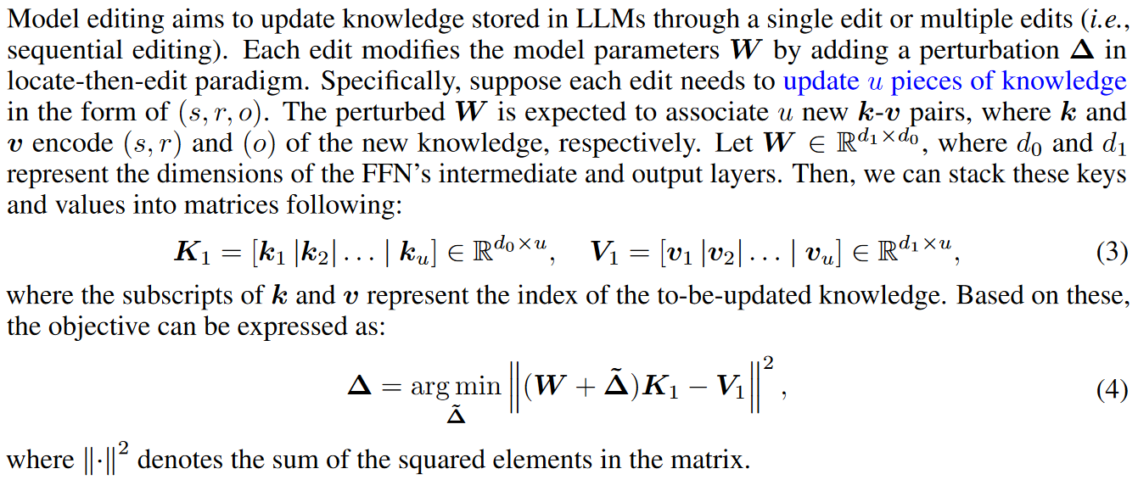
What is model editing

Slide 49
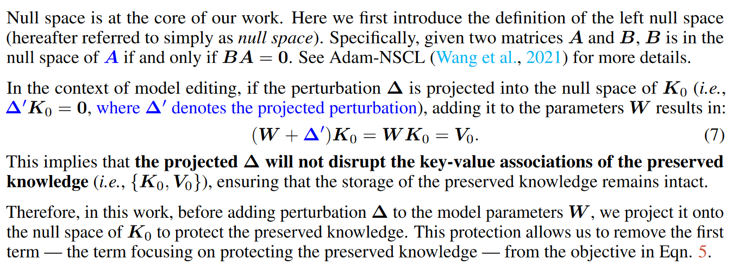
AlphaEdit: Null-Space Constrained Model Editing for Language Models

Slide 50
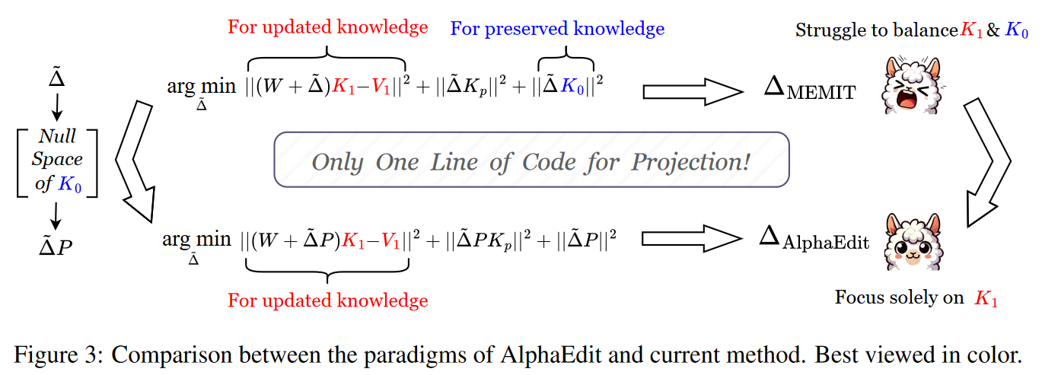
AlphaEdit: Null-Space Constrained Model Editing for Language Models

Slide 51
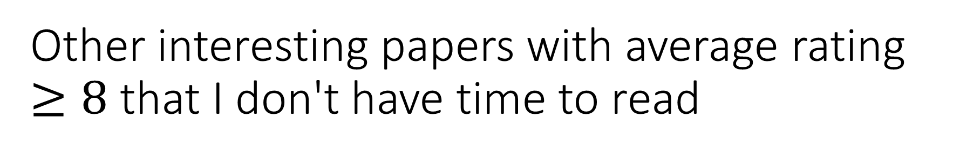
Other interesting papers with average rating $≥8$ that I don't have time to read
Training Language Models to Self-Correct via Reinforcement Learning
Transformers Provably Solve Parity Efficiently with Chain of Thought
BIRD: A Trustworthy Bayesian Inference Framework for Large Language Models
Interpolating Autoregressive and Discrete Denoising Diffusion Language Models
LoRA Done RITE: Robust Invariant Transformation Equilibration for LoRA Optimization
Spider 2.0: Can Language Models Resolve Real-World Enterprise Text-to-SQL Workflows?
Cybench: A Framework for Evaluating Cybersecurity Capabilities and Risks of Language Models
Sparse Feature Circuits: Discovering and Editing Interpretable Causal Graphs in Language Models
Booster: Tackling Harmful Fine-tuning for Large Language Models via Attenuating Harmful Perturbation
WizardMath: Empowering Mathematical Reasoning for Large Language Models via Reinforced Evol-Instruct
Measuring and Enhancing Trustworthiness of LLMs in RAG through Grounded Attributions and Learning to Refuse
Topological Blindspots: Understanding and Extending Topological Deep Learning Through the Lens of Expressivity

